Slide 1

Skydiving Database System
Group E: Vince Carter, Ian Pakka, Jake Watsky, Jeff Jones, Elijah Rosenfeld

Slide 2
The Problem/Opportunity
Inefficient data usage for marketing initiatives, forecasting, vehicles maintenance, etc..
Forecasting will allow managers to look at historical data to understand what months are high demand and low demand
We can segment our customers to offer different promotions or ads
Opportunity to provide customers with status of license (We will be able to track the specific number of jumps they have done along with the type, height, and fall duration)
Problems with inventory regarding equipment, air vehicle, and land vehicles statuses
New system can give real time status on what equipment is available vs in repair
Mechanics will know what vehicles are in need of inspection or coming close to needing inspection

Slide 3
Benefits
ROI (Return on Investment):
Cost savings through increased efficiency.
Improved safety measures reducing potential liabilities.
Improved Customer Experience:
Seamless scheduling and communication.
Enhanced customer interactions.
Time Efficiency:
Reduced time spent on administrative tasks.
Faster response to operational needs.
Enhanced Safety:
Improved safety record management.
Timely identification and resolution of safety concerns.

Slide 4
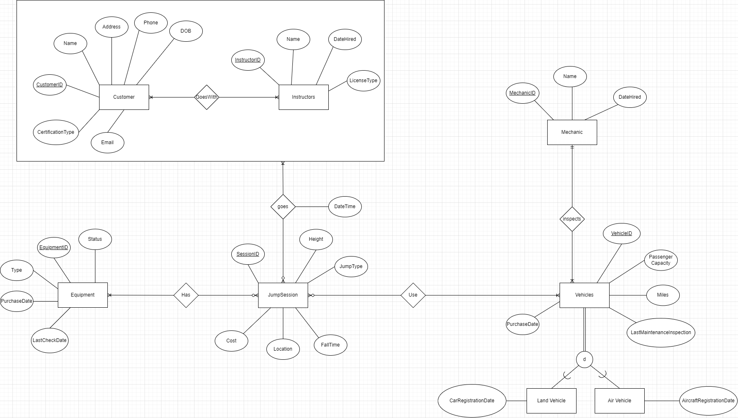
ERD
Notes:
Assumption: You can be a customer without going on a jump, Instructors have to have at least license Class A.
Primary Relationships
Jump Sessions + Jumpers
Jump Sessions have various jump types, location, cost, fall time
Jumpers is an aggregated entity with Customers and Instructors
With instructor information, we ensure appropriate LicenseType
Customer information is tracked, as well as providing any Certifications they have earned
Jump Sessions + Equipment
Also connected to JumpSessions is the equipment, in which we’re tracking the Status (available / in repair) and when it was last checked
Jump Sessions + Vehicles
Vehicles are used with each JumpSession, both air and land vehicles. Important attributes include Miles and Last Mechanic Inspection
Cardinality
Each customer will go with at least one instructor, and instructors will go with at least one customer
Each jumper pair will have at least one jump session and each jump session will have at least one jumper pair.
Each jump session will need to have equipment, but shops need to keep record of new equipment that is yet to be used.
Similarly, each jump session will require a vehicle, but shops will keep record of new vehicles that are yet to be used.
Vehicles will be inspected by only one mechanic, but mechanics are expected to inspect multiple vehicles.

Slide 5
Schema Mapping
CUSTOMER(CustomedID, Name, Address, Phone, DOB, Email, CertificationType)
INSTRUCTORS(InstructorID, Name, DateHired, LicenseType)
EQUIPMENT(EquipmentID, Type, PurchaseDate, LastCheckDate, Status)
JUMPSESSION(SessionID, JumpType, FallTime, Location, Cost)
VEHICLES(VehicleID, PassengerCapacity, Miles, LastMaintenanceInspection, PurchaseDate, MechanicID[FK])
MECHANIC(MechanicID, Name, DateHired)
GOESWITH(CustomerID[FK], InstructorID[FK])
GOES(CustomerID[FK], InstructorID[FK], SessionID[FK], Date)
HAS(EquipmentID[FK], SessionID[FK])
USE(SessionID[FK], VehicleID[FK])
LANDVEHICLE(VehicleID[FK],CarRegistrationDate)
AIRVEHICLE(VehicleID[FK], AircraftRegistrationDate)

Slide 6
Data Sources
The data we used is fictitious, however we used real world JumpTypes, locations, Equipment types, and instructor licenses.
We primarily used ChatGPT to generate the data for us, we wrote one insert statement and asked ChatGPT to generate additional rows with constraints on specific columns.
This method worked well and allowed us to generate sufficient data to show the benefits of our database system.

Slide 7
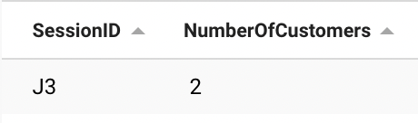
Query 1: Do any sessions have customers going together?
SELECT SessionID, COUNT( CustomerID) AS NumberOfCustomers FROM JumpSession
Natural JOIN Goes
Natural JOIN Customer
GROUP BY SessionID
HAVING COUNT(CustomerID) >= 2;
Impact
We could see which customers like to go in groups.
Discounts could be offered if multiple people go on a session together.
This could encourage people to introduce first-time skydivers or encourage people who like to go with friends to go more frequently.

Slide 8
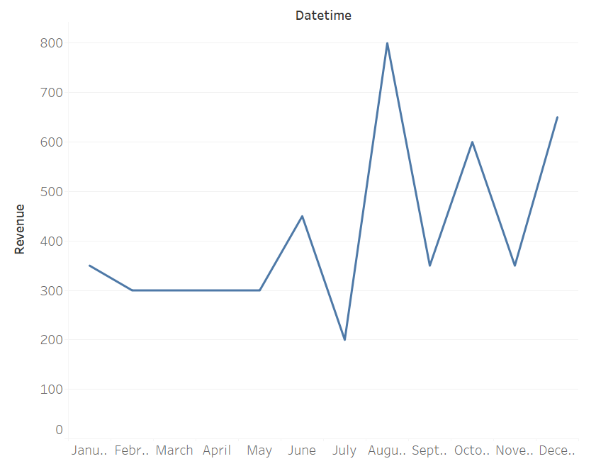
Query 2: Revenue/Demand Forecasting
SELECT datetime, count(CustomerId), sum(cost) FROM Jumpsession natural right join goes group by month(datetime);
This query allows management to have a better understanding of demand based on month.
As we continue to collect data we should be able to better predict demand.
Currently it appears August is the highest demand month.

Slide 9
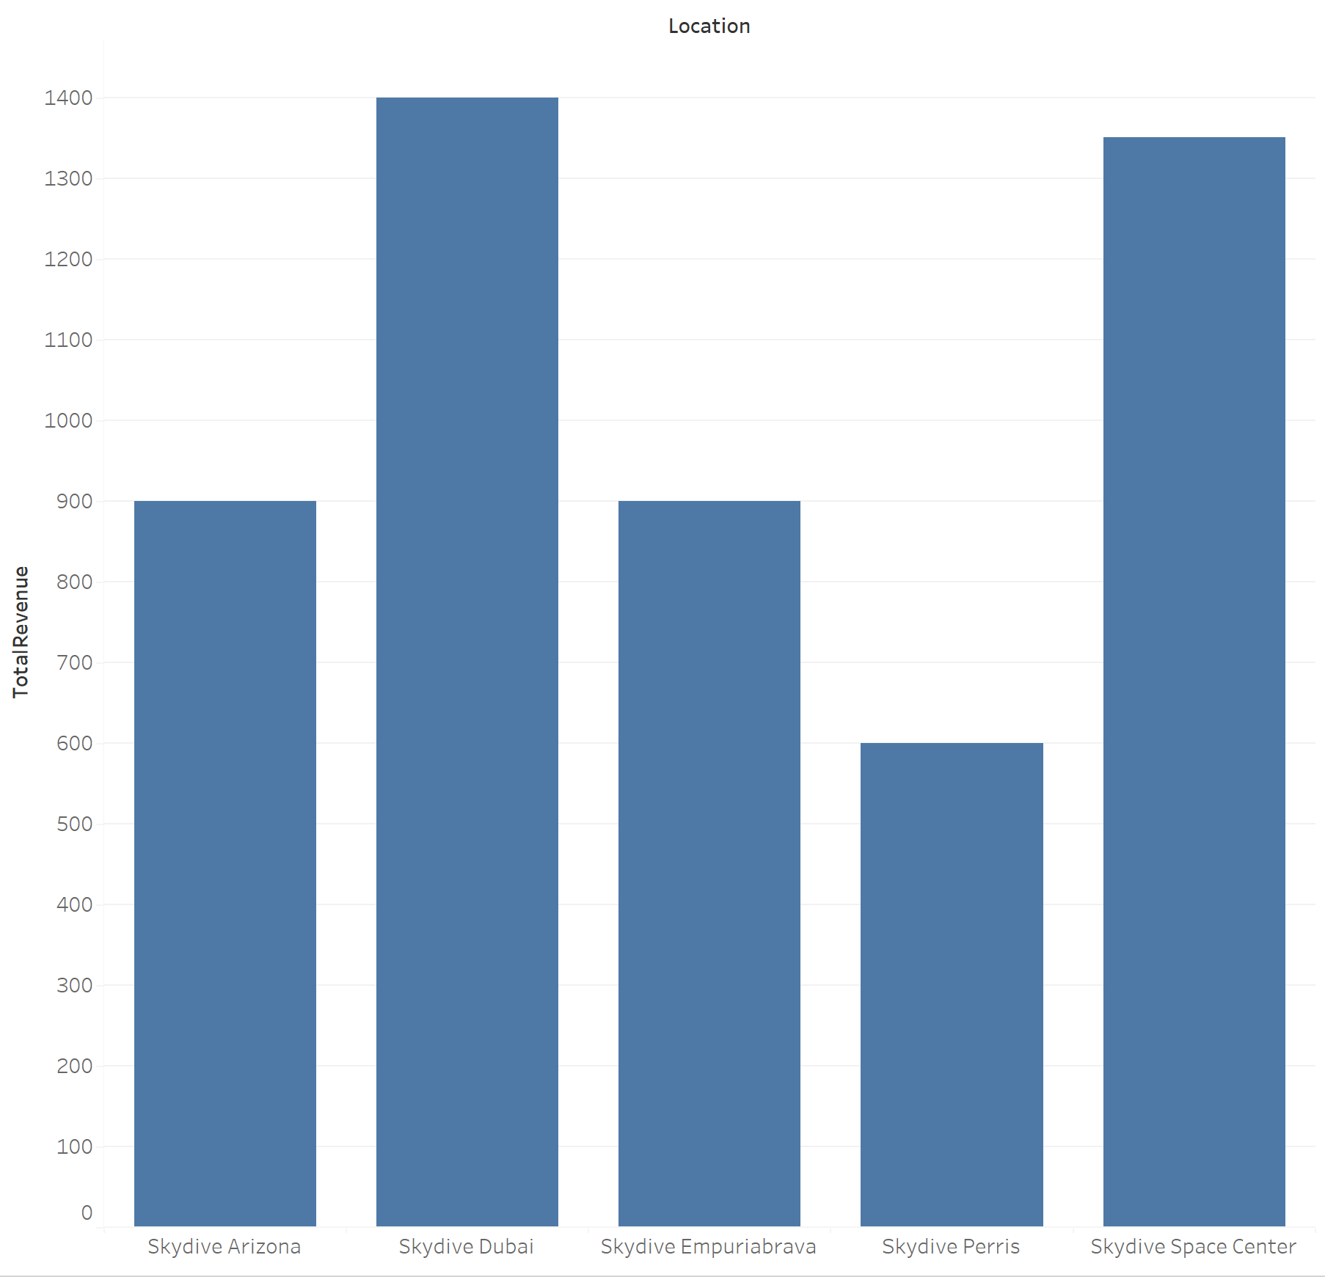
Query 3: Revenue Based on Location
SELECT Location, AVG(Cost) as AverageRev, COUNT(CustomerID) as NumberOfCustomers, SUM(Cost) as TotalRevenue
FROM JumpSession natural join goes
GROUP BY Location
ORDER BY TotalRevenue DESC;
Insights
New jump locations
Where to prioritize
Our customer demographics

Slide 10
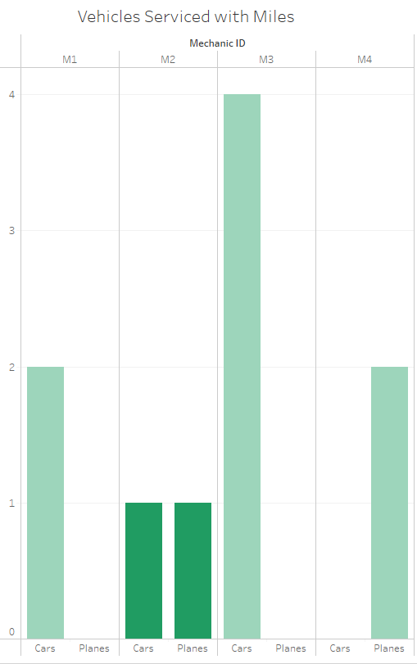
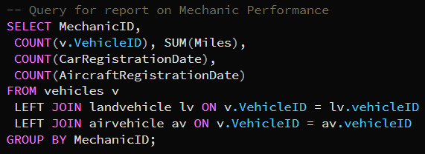
Query 4: Mechanic Performance
This skydiving company is looking ahead towards growth, and it values promotion from within. Rather than hiring a 5th mechanic to improve inspection times, the CEO decides to promote one mechanic into a management.
Now that a database is established, he easily queries a report to understand mechanic’s performance. He analyzes the vehicle’s last inspection, with a bar chart to show how many vehicles each mechanic inspected. He chooses to shade the bars based on total number of miles at the vehicles inspection.
CEO concludes that Mechanic 2 is ready for management, being well-rounded and knowledgeable with cars and planes, as well as inspecting vehicles with high mileage.
Data is generated by ChatGPT with manipulation.

Slide 11
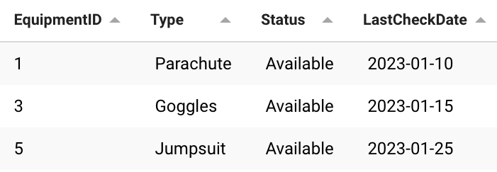
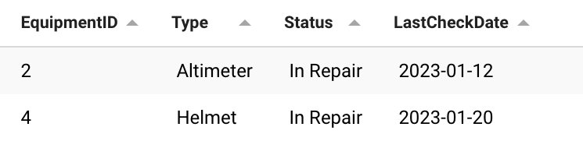
Query 5: Equipment Status
SELECT EquipmentID, Type, Status, LastCheckDate
FROM Equipment where status = 'Available';
SELECT EquipmentID, Type, Status, LastCheckDate
FROM Equipment where status = 'In Repair';
This query allows for management to view specific outputs regarding each type of equipment and reading whether it is available or in repairs.
Provides a comprehensive view of all equipment in the database, including their unique EquipmentID, type, current status (available or in repair), purchase date, and the date of the last equipment check.
This information is crucial for skydiving operations to ensure that equipment is available for use, and to track when equipment is in need of repair or maintenance.

Slide 12
Thank You!

